Slide 1
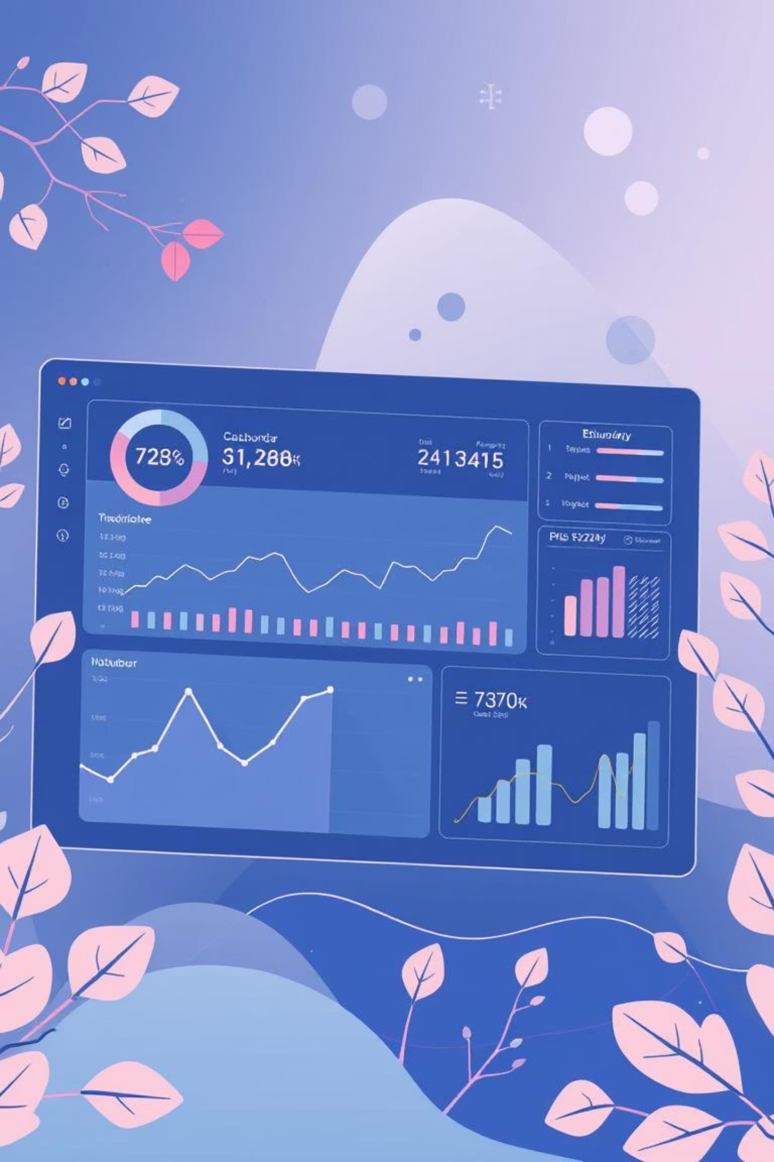
AI-Powered Expense Tracker: Your Financial Co-Pilot
Welcome to the future of personal finance management. Our web application combines the power of Artificial Intelligence with intuitive design to give you unprecedented control over your money.

Slide 2

Navigating Your Financial Landscape
In today's fast-paced world, managing personal finances can feel overwhelming. Many struggle to track spending, understand where their money goes, and make informed budgeting decisions.
The Challenge
Lack of Insight
Manual expense tracking is time-consuming and prone to errors.
Difficulty identifying spending patterns and areas for saving.
Future Uncertainty
Struggling to plan for financial goals without clear data.

Slide 3

Our Intelligent Solution: How It Works
The AI-Powered Expense Tracker streamlines your financial management by automating key processes and providing actionable insights.
01
02
Track & Log
AI Categorization
Effortlessly input or import your daily transactions in real-time.
Our intelligent system automatically categorizes your expenses for clear organization.
03
04
Analyze Patterns
Smart Recommendations
Uncover spending habits, recurring costs, and where your money truly goes.
Receive personalized, AI-driven advice for better budgeting and saving.

Slide 4
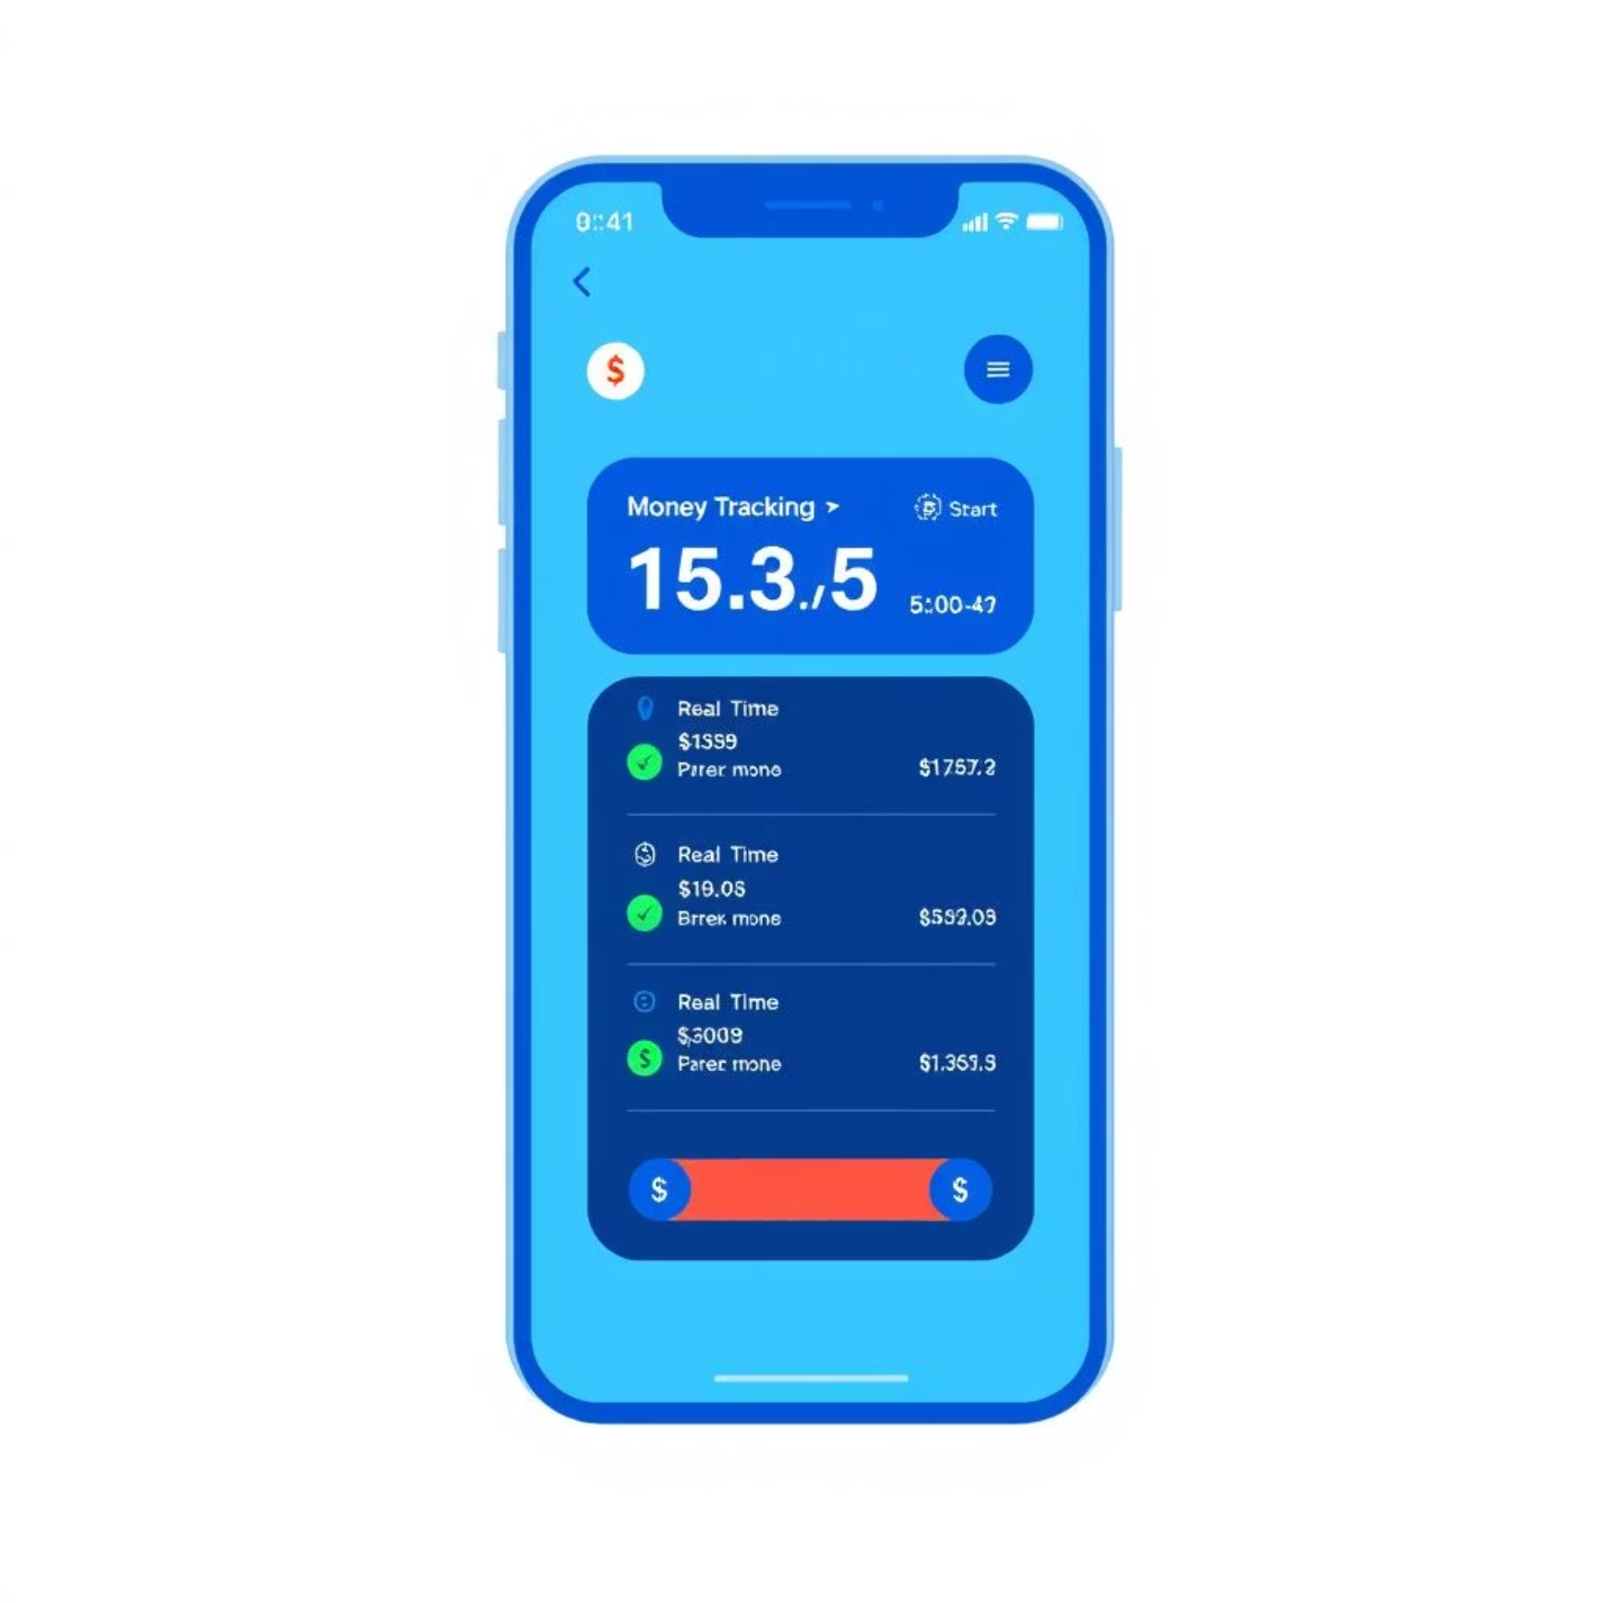

Core Features for Financial Empowerment
Real-Time Expense Tracking
AI-Based Categorization
Log transactions as they happen, ensuring your financial overview is always current. See your balances update instantly, giving you precise control.
Say goodbye to manual sorting. Our AI automatically classifies your spending, from groceries to entertainment, making budgeting effortless.

Slide 5
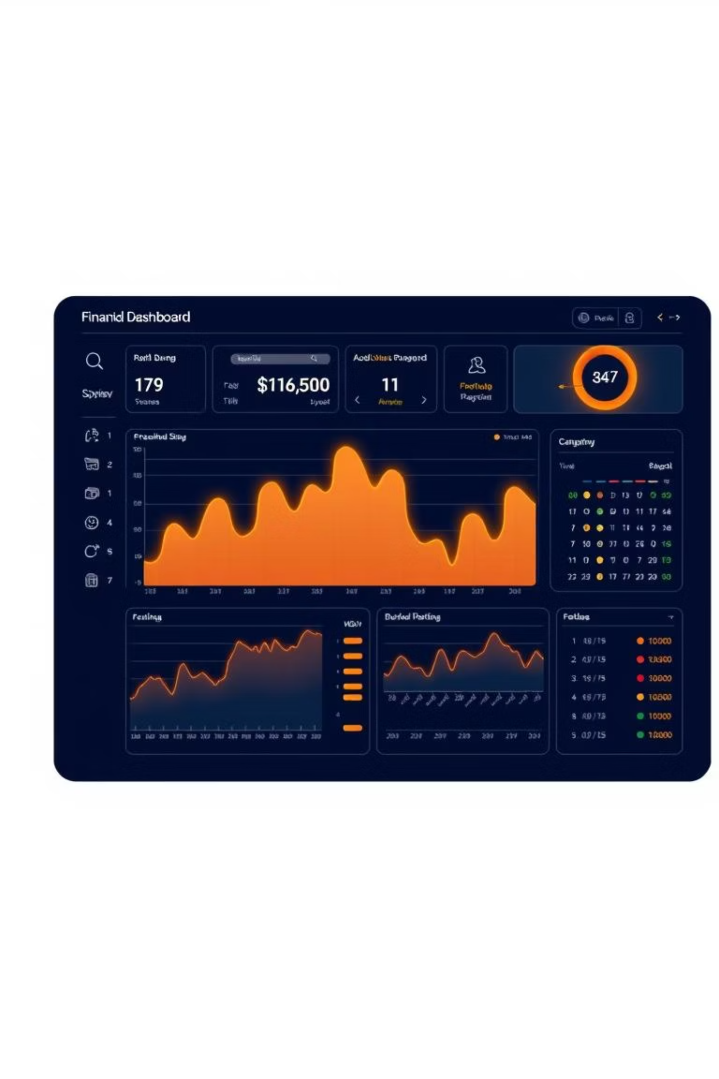


Advanced Insights & Visualizations
Interactive Visual Dashboards
Gain clarity with intuitive graphs, charts, and summaries that transform raw data into understandable insights.
Predictive Financial Insights
Leverage AI to forecast future spending, identify savings potential, and make smarter, proactive financial decisions.

Slide 6

Tailored for Every User: Students
Empowering Student Finances
For students navigating their first taste of financial independence, our app is an invaluable tool.
Budgeting Basics
Easily track and visualize spending on textbooks, food, and social activities.
Financial Awareness
Develop healthy money habits early by understanding where every dollar goes.

Slide 7

Tailored for Every User: Working Professionals
Optimizing Professional Finances
Working professionals can gain deeper insights into their financial health, maximizing savings and investment opportunities.
Recurring Expenses
Quickly identify and manage monthly subscriptions, bills, and other fixed costs.
Savings Opportunities
Receive intelligent recommendations to cut unnecessary spending and boost your savings rate.

Slide 8

Tailored for Every User: Administrators
Comprehensive Data Oversight
For technical administrators, the platform offers robust tools for user data oversight and trend monitoring.
Monitor Usage Patterns: Track overall user engagement and feature adoption.
Aggregate Data Analytics: Observe anonymized spending trends and demographic insights across the user base.
System Health & Security: Ensure data integrity and privacy with advanced monitoring tools.

Slide 9
The Future of Smart Money Management
Our AI-Powered Expense Tracker is more than just an app; it's a foundation for a healthier financial future.
Alerts & Reminders
1
Never miss a bill or overspend with smart notifications.
Investment Suggestions
2
AI-driven recommendations for growing your wealth.
Goal-Based Planning
3
Track progress towards specific financial milestones (e.g., home, retirement).
It's a user-friendly, visually appealing, and practical solution designed to evolve with your financial needs.

